Slide 1
W-8BEN-E Form
Certificate of Foreign Status of Beneficial Owner for United States Tax Withholding and Reporting (Entities)

Slide 2
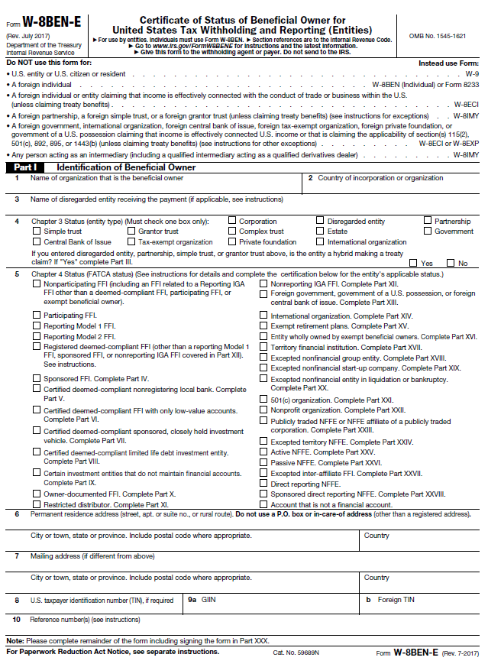
A. Please read this section and the associated instructions to ensure you are completing the correct W-form.
B. PART I - Identification of Beneficiary Owner
Line 1 Full Name of entity that is the beneficial owner.
Line 2 Country of registration.
Line 3 Name of disregarded entity receiving the payment (if applicable).
Line 4 You must check the box that represents your classification. (must only check one box).
Line 5 Check the one box that applies to your chapter 4 status in your country of residence. For most of the statuses you are required to complete an additional part of this form confirming that you meet the conditions of the status indicated on line 5.
Line 6 Enter the permanent residence address of the entity identified in line 1.
DO NOT USE: PO Box or C/O address, Name of a third party, Address at a
Financial Institution, US address.
Line 7 Enter your mailing address only if it is different from the address on line 6.
Note: If a U.S mailing address is entered or the country differs to the country in the permanent residence address, a written explanation/reason will be required.
Line 8 Enter your U.S. Tax Identification Number (TIN).
Line 9a Enter your Global Intermediary Identification Number (GIIN)
Line 9b Enter your Foreign Tax Identification Number.
Line 10 Only complete if applicable
Please see page 6 - 8 under Specific Instructions for further detailed clarification.
A
B

Slide 3
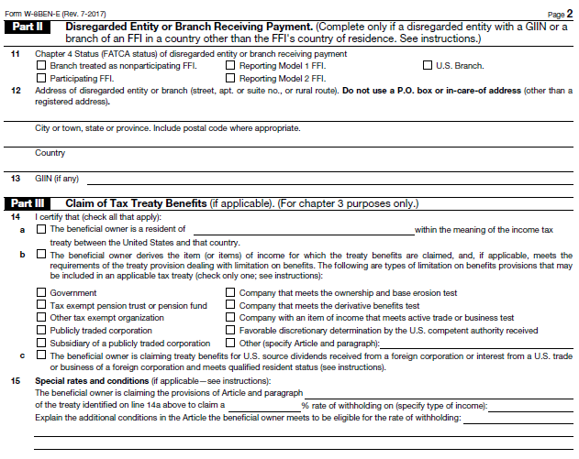
C. PART II - Disregarded Entity or Branch Receiving Payment
Line 11 & 12 Complete only if disregarded entity with a GIIN or a branch of an FFI in a country other than the FFI’s country of residence.
D. PART III - Claim of Tax Treaty Benefits (if applicable)
Line 14a Tick the box and insert country of residency.
Line 14b OR 14c Tick either box as applicable.
Limitation on Benefit provisions (LOB) Check only one box, on which you are relying to claim treaty benefits.
Line 15 Complete only if you are claiming treaty benefits that require that you meet conditions not covered by the representations you make in line 14.
Limitation on Benefits (LOB) for Treaty Claims If you are a non-U.S. entity claiming treaty benefits in respect to an income tax treaty concluded with the United States, please refer to the relevant instructions on the form with respect to LOB provisions contained within the treaty.
Please see page 9, 10 & 11 under Specific Instructions for further detailed clarification.
C
D

Slide 4
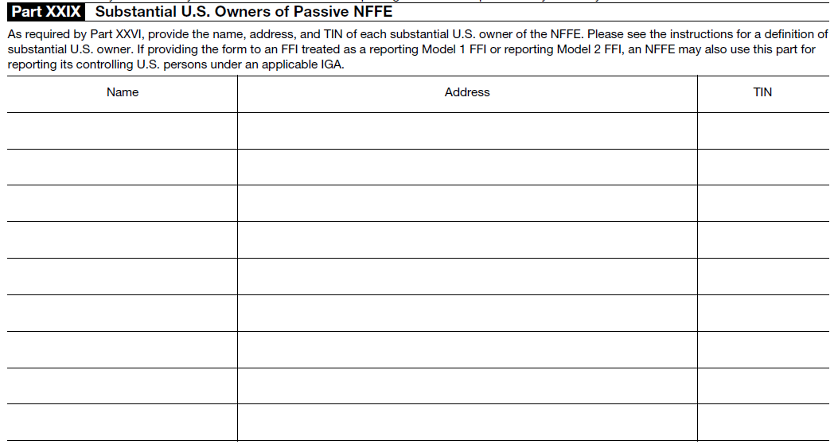
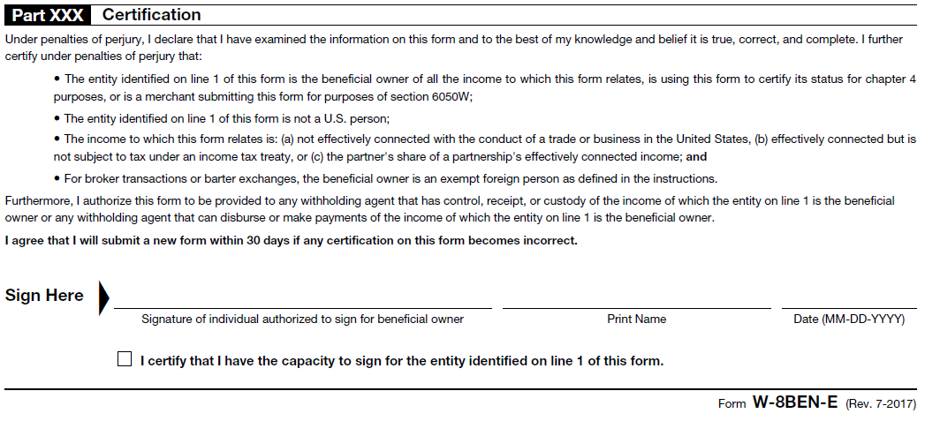
The remaining parts of the form (part IV till part XXVIII) include specific certifications relating to the chapter 4 status you ticked in Part I, line 5.
For this portion of the form, you are required to complete only the certification applicable to Your chapter 4 status.
F. Part XXIX - Substantial U.S. Owners of Passive NFFE
Complete only if part XXVI is completed and only if applicable.
Please provide the name and TIN of each substantial U.S. owner of the NFFE.
G. Part XXX - Certification
You must be authorised to sign on behalf of the entity on line 1.
Please sign the form in accordance to the binding powers of your entity.
Please print your name on the line next to your signature.
Please date the form using the MM/DD/YYYY format.
Please tick here “I certify that I have the capacity to sign for the entity identified on line 1 of the form”.
Please see page 9, 10 & 11 under Specific Instructions for further detailed clarification.
F
G

